Slide 1
IEO – week 7

Slide 2
This week
Network Layers (TCP/IP )
Network Device
Notes:
Applies to al electronic devices?

Slide 3
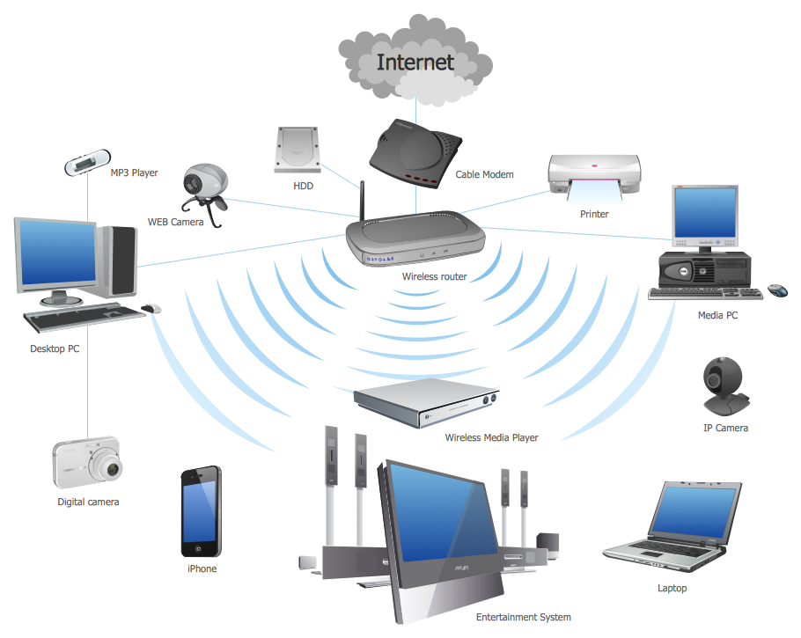
What Is a Computer Network ?
Networking technology is about
NNetworking technology is about
Networking
The internet
The home network
Configuration of networks and diagnostics
Networking model (tcp/ip model)
etworking
The internet
The home network
Configuration of networks and diagnostics
Networking model (tcp/ip model)

Slide 4

Computer Network
Internet

Slide 5
Computer Network
Internet
WAN
242.124.345.644
33:5A:1A:50:65:CA
172.16.0.1
192.168.0.88
192.168.0.10
64:58:73:F0:EF:03
47:CA:DF:AB:41:40
34:40:36:71:1A:0E
172.16.0.2
LAN2
F4:77:59:3B:0E:62
192.168.0.16
D2:36:D2:0A:53:3A
192.168.0.101
192.168.0.1
0F:9B:88:A1:05:93
02:6A:2B:63:11:4D
LAN1
192.168.0.1
70:AB:35:DB:C3:68
192.168.0.15
62:FC:AE:05:5E:07
192.168.0.12
FF:88:FB:35:D4:50
192.168.0.233
192.168.0.100
D7:01:95:88:F0:37
B3:2B:C6:14:CC:81
Notes:
Broadcast domain
http://noshankus.blogspot.com/2009/06/switching.html
https://study-ccna.com/collision-broadcast-domain/

Slide 6

How Do All These Devices Communicate ?

Slide 7


Layered Communication
Layer 5
Layer 5
Layer 4
Layer 4
Communication SW/HW
Protocol
Communication SW/HW
Layer 3
Layer 3
Layer 2
Layer 2
Layer 1
Layer 1
Transmission Medium

Slide 8
Layered Communication: Encapsulation & Decapsulation
Layer 5
Layer 5
Layer 4
Layer 4
Layer 3
Layer 3
Layer 2
Layer 2
Layer 1
Layer 1
Transmission Medium
1100101010001…

Slide 9
Layered Communication: TCP/IP Model Layers
Layer Function
Application Layer
Interface to User Application
Application Layer
Transport Layer
Peer to Peer Application Communication
Transport Layer
Network Layer
Host to Host Communication/Routing
Network Layer
DataLink Layer
Hop to Hop (Neighbour) Communication
DataLink Layer
Physical Layer
Interface to Physical Medium
Physical Layer
Transmission Medium

Slide 10
Layered Communication: TCP/IP and OSI Model
OSI Reference Model
TCP/IP Model
Application Layer
Presentation Layer
Session Layer
Application Layer
Transport Layer
Transport Layer
Network Layer
Network Layer
DataLink Layer
DataLink Layer
Physical Layer
Physical Layer

Slide 11
Layered Communication: TCP/IP Addressing
Addressing
Application Layer
Application specific: e.g. For HTTP
URL “www.google.com”
Application Layer
Transport Layer
Ports : e.g. For HTTP port 80
Transport Layer
Network Layer
IP Address : e.g. 192.168.1.2
Network Layer
DataLink Layer
MAC Address : e.g. 06:84:F4:E2:12:22
DataLink Layer
Physical Layer
N.A.
Physical Layer
Transmission Medium

Slide 12


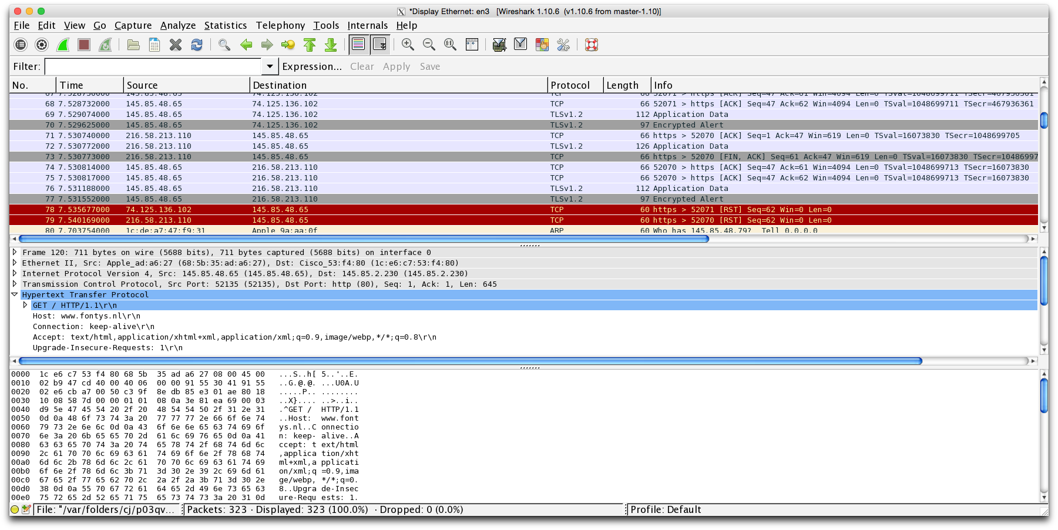
Wireshark Network Sniffing Tool

Slide 13
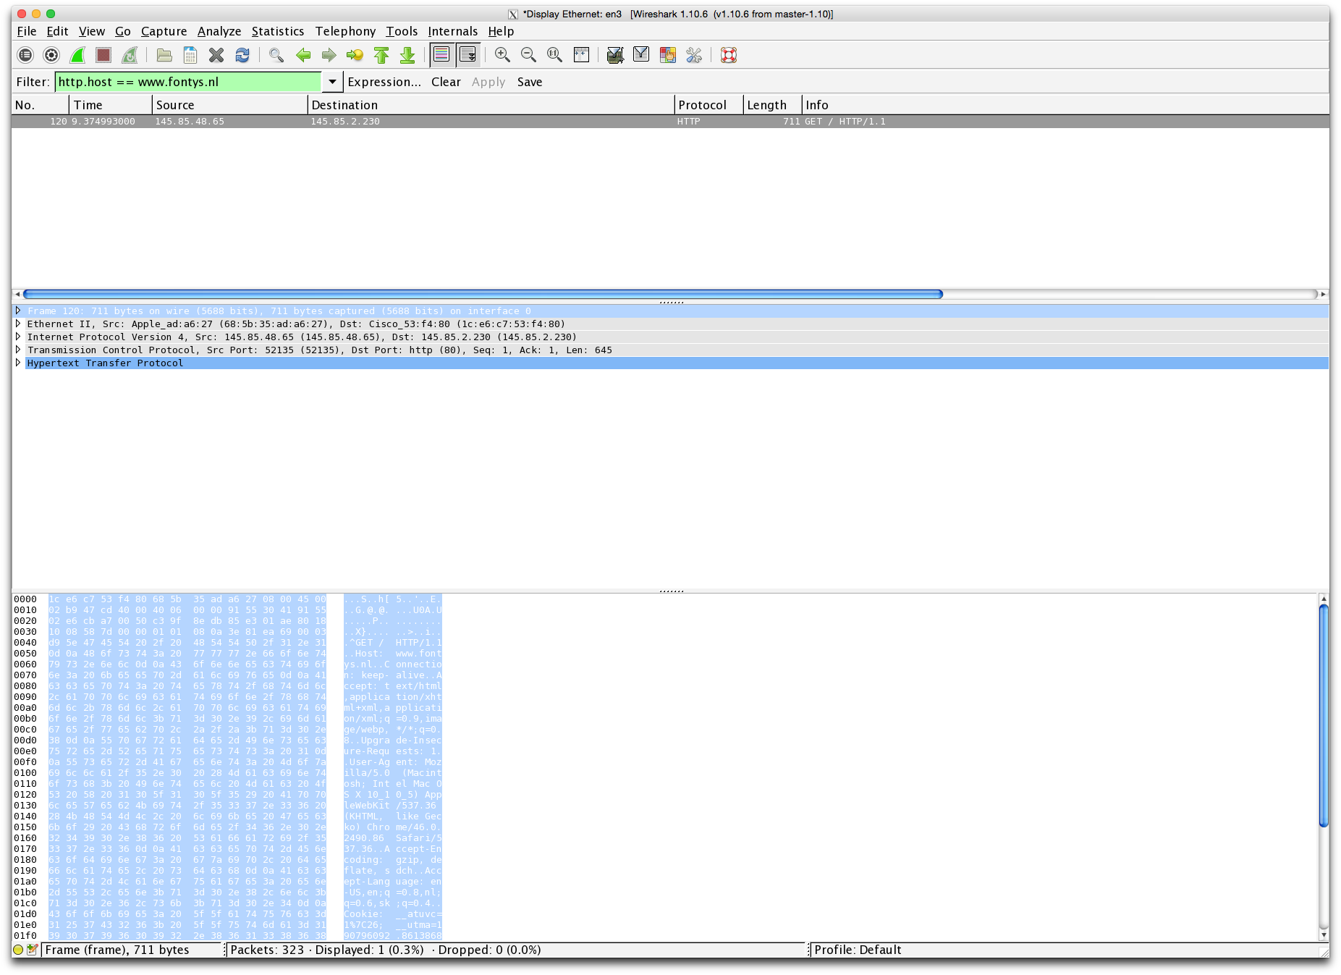
Encapsulation Example (1)
Encapsulation Example : HTTP packet in Wireshark (1)
TCP/IP Layers
HTTP packet in binary form

Slide 14
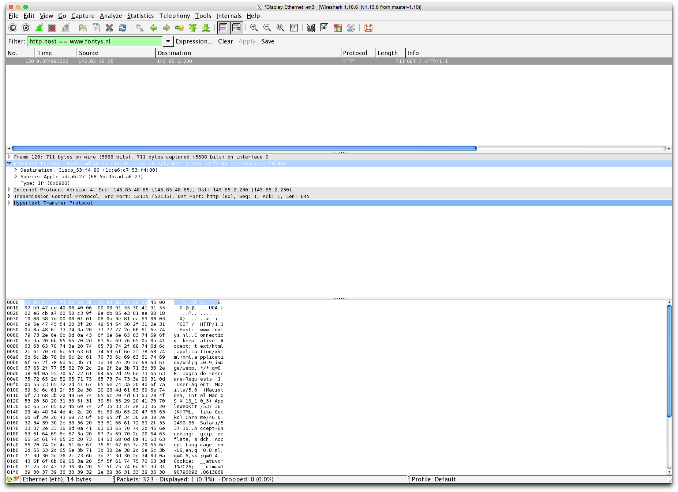
Encapsulation Example : HTTP packet in Wireshark (2)
Data Link Layer (Ethernet)

Slide 15
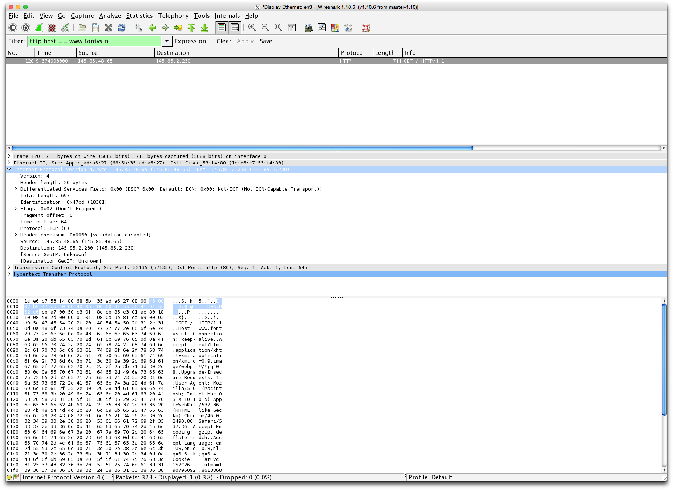
Encapsulation Example : HTTP packet in Wireshark (3)
Network Layer (IP)

Slide 16
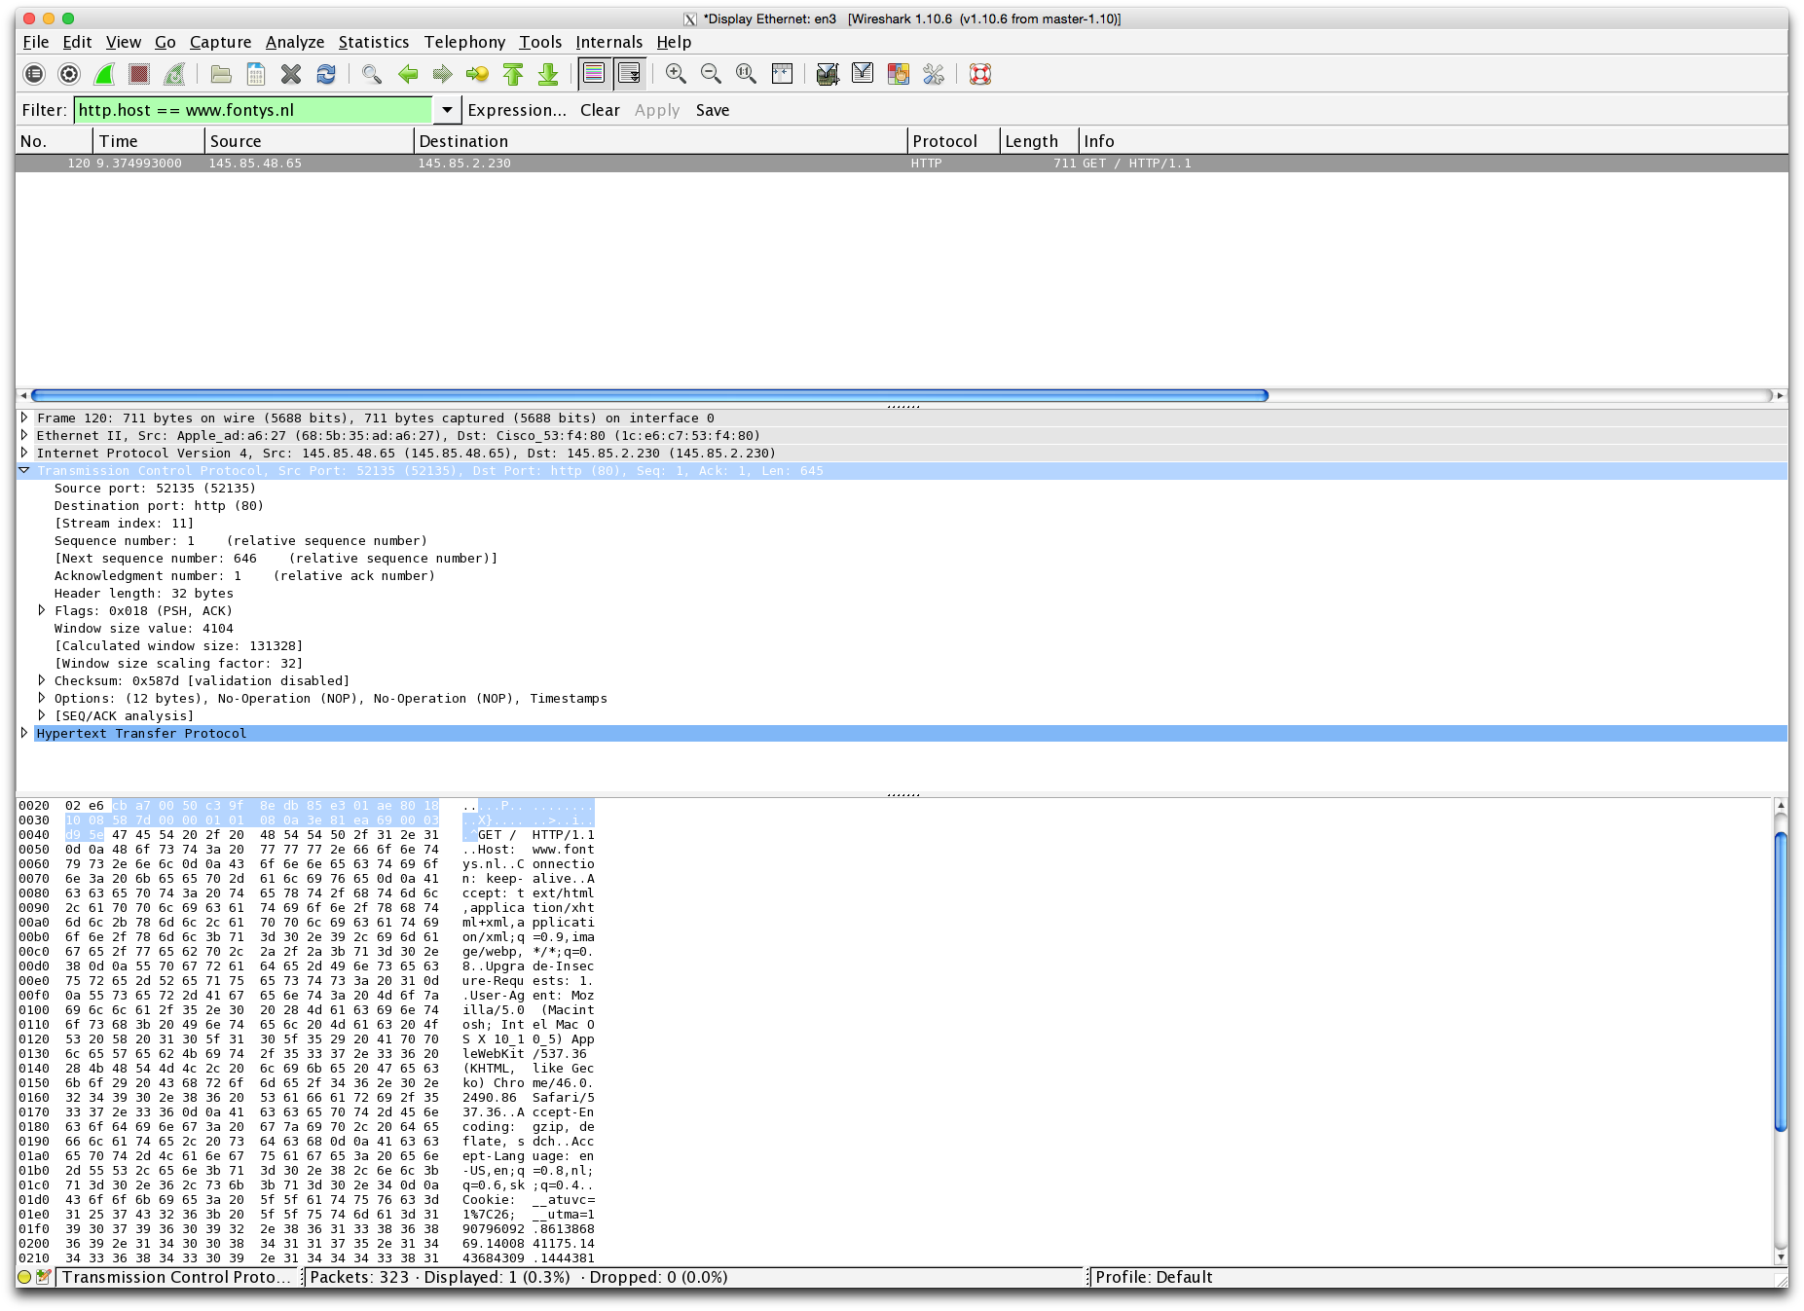
Encapsulation Example : HTTP packet in Wireshark (4)
Transport Layer (TCP)

Slide 17
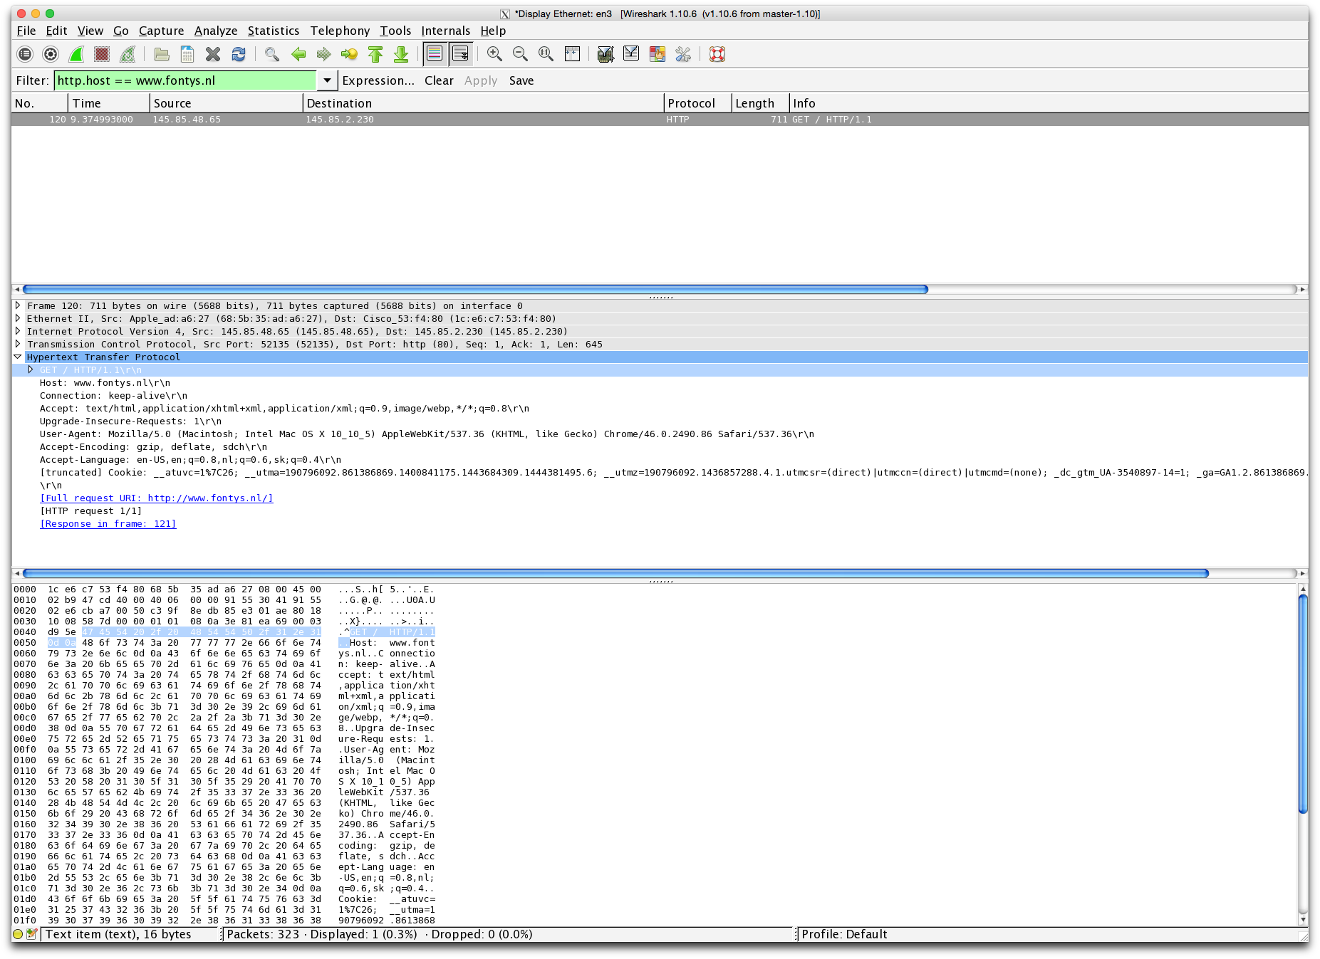
Encapsulation Example : HTTP packet in Wireshark (5)
Application Layer (HTTP)

Slide 18
Layered Communication: Hub, Router, Switch
Application Layer
Application Layer
Transport Layer
Transport Layer
Network Layer
Router
Network Layer
DataLink Layer
Switch
DataLink Layer
Physical Layer
Hub
Physical Layer
Transmission Medium

Slide 19
Layered Communication: Hub, Router, Switch
Host
Host
Router
Router
Application Layer
Hub
Switch
Application Layer
Transport Layer
Transport Layer
Network Layer
Network Layer
Network Layer
Network Layer
DataLink Layer
DataLink Layer
DataLink Layer
DataLink Layer
DataLink Layer
Physical Layer
Physical Layer
Physical Layer
Physical Layer
Physical Layer
Physical Layer

Slide 20
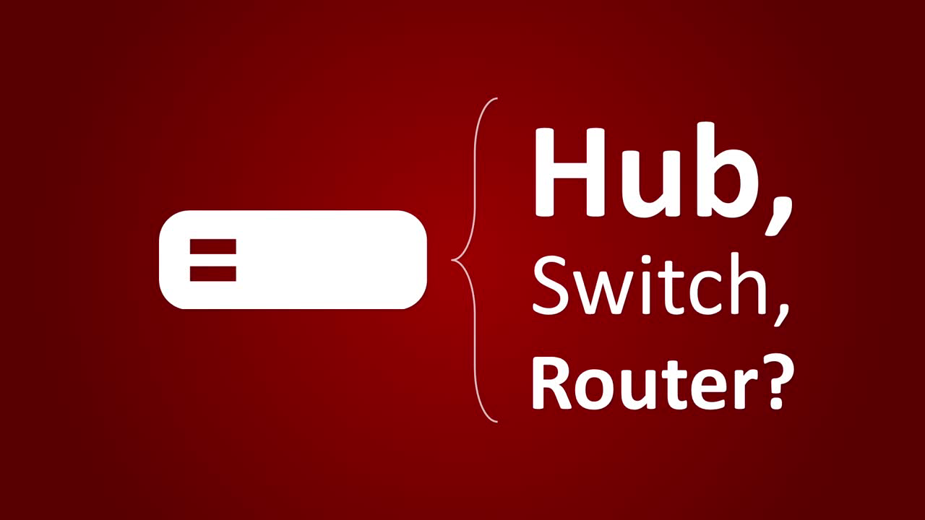

Slide 21
Layered Communication: TCP/IP Protocols Overview
Application Layer
HTTP
DNS
FTP
DHCP
DHCP
Telnet
SMTP
Transport Layer
TCP
UDP
Network Layer
IP
DataLink Layer
Ethernet
Wifi
Bluetooth
Physical Layer
Ethernet
Wifi
Bluetooth

Slide 22

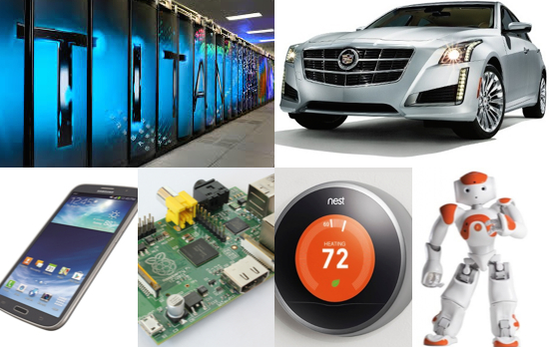
Linux
From smartphones to cars, supercomputers and
home appliances, the Linux operating system is everywhere.

Slide 23
Linux Advantages
Free
Secure
Stable
Good hardware support
Flexible and configurable
… and many more

Slide 24
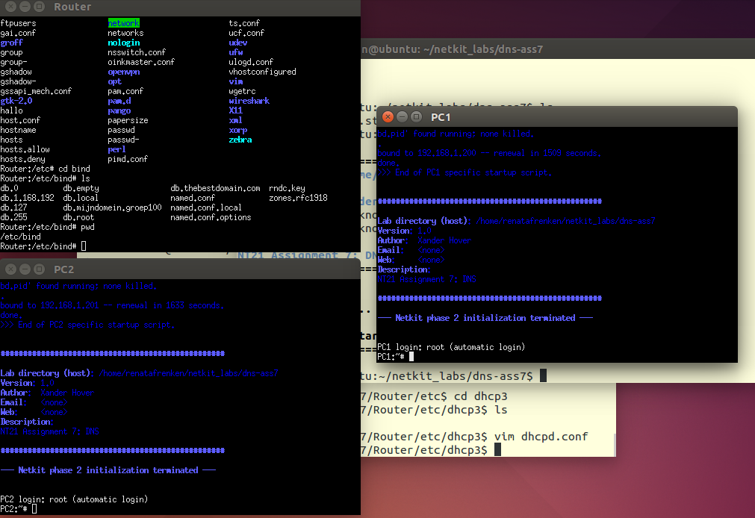
Netkit
…to experiment with computer networking.

Slide 25
Netkit
Uses User Mode Linux (UML) to simulate network nodes
Virtual machines are connected through virtual data network
Virtual machines can be configured to run network clients, servers, switches or routers

Slide 26
Netkit basics
Create and start a virtual machine:
vstart command
Example:
vstart PC1 --eth0=A
vstart PC2 --eth0=A
Start two VMs named PC1 and PC2 which are connected to a collision domain named A.

Slide 27
Netkit basics
Halt a virtual machine:
vhalt command
Example:
vhalt PC1
vhalt PC2
Gracefully shuts down VMs named PC1 and PC2.

Slide 28
Netkit basics
List running virtual machines:
vlist command
Example:
vlist
Shows information about all currently running virtual machines.

Slide 29
Netkit basics
Help about all netkit commands can be found by using Linux command man
man command
Example:
man lstart
Shows the manual pages for the netkit lstart command.

Slide 30

Questions?

